Slide 1

Fabric Licensing

Slide 2
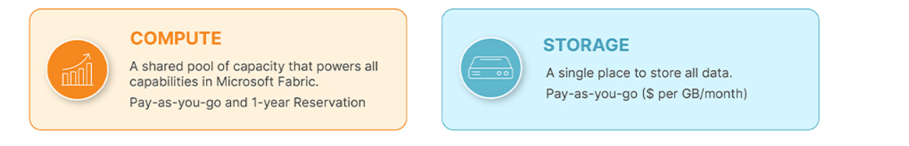
Simplified Pricing Structure
1. Compute Capacity: A single compute capacity can support all functionalities concurrently, which can be shared across multiple projects and users without any limitations on the number of workspaces utilizing it. You do not need to select capacities individually for Data Factory, Synapse Data Warehousing, and other Fabric experiences.
2. Storage: Storage costs are separate yet simplified, making choices easier for the end customer.

Slide 3
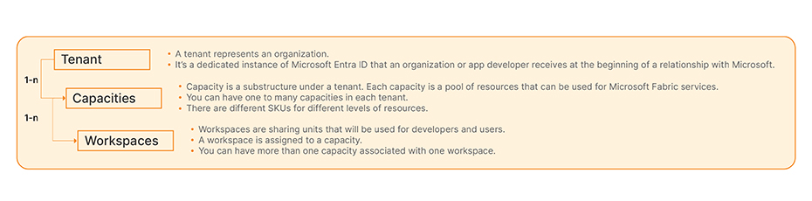
Fabric’s Capacity Structure
For a single tenant, no matter how many capacities you allocate to different workloads which have a 1:n relationship, you will only have a single OneLake , that is, a single unified storage for the whole tenant
Pricing Models
In Microsoft Fabric, capacities are containers that provide dedicated compute and storage resources for running various data and analytics workloads.
Reserved
PAYG

Slide 4
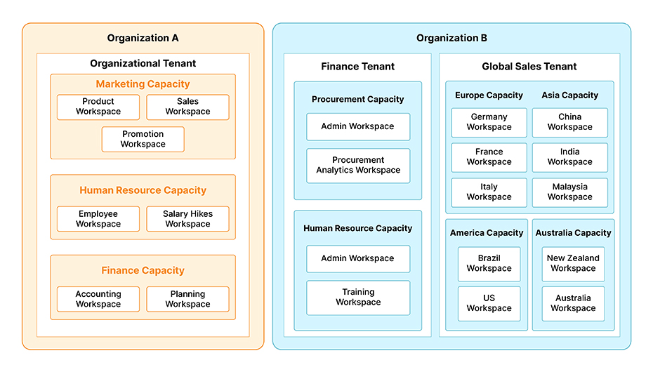
Microsoft Fabric supports multiple tenants under a single subscription or across different subscriptions, allowing centralized management of capacities.
Within a single tenant in Microsoft Fabric, you can allocate multiple SKUs (capacities) to different groups, departments, or use cases while maintaining one OneLake instance and unified storage costs.
Workspaces: Each workspace in the diagram corresponds to a logical workspace in Microsoft Fabric, where datasets, reports, pipelines, and other artifacts are created and managed.
Organizations can allocate specific Fabric capacities (e.g., F2, F4) to these workspaces based on their compute and storage requirements.

Slide 5
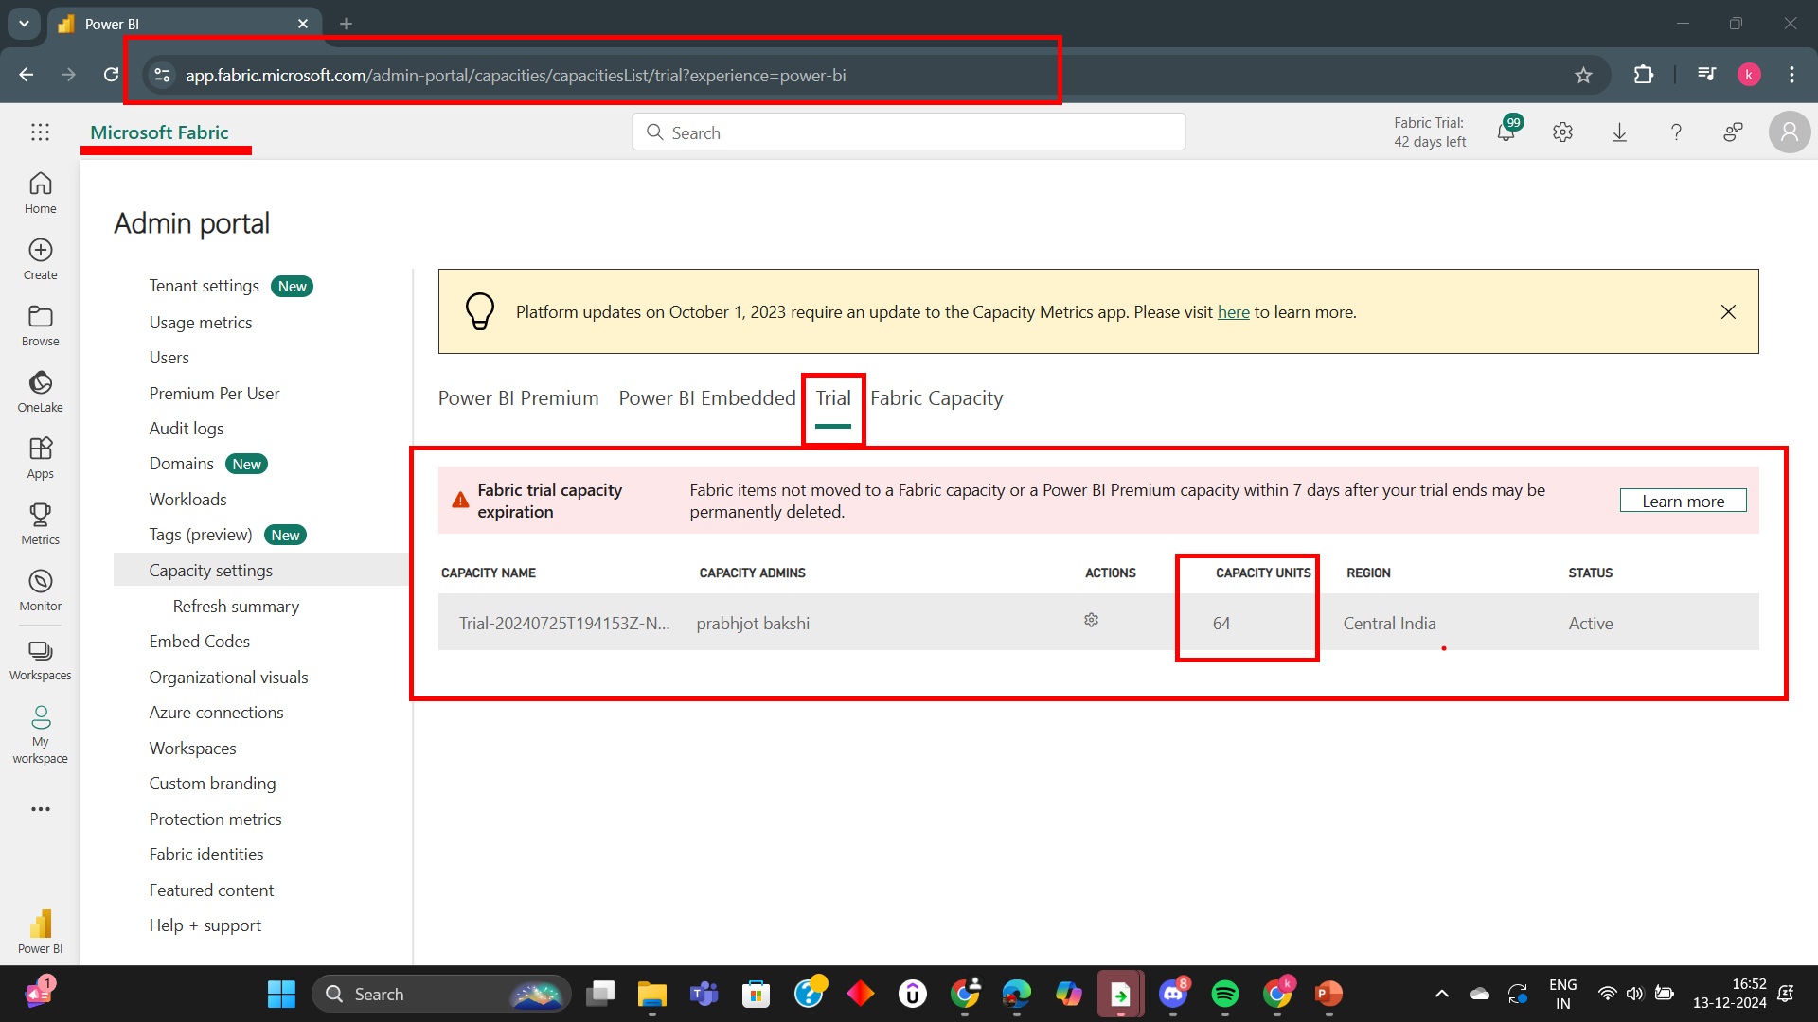
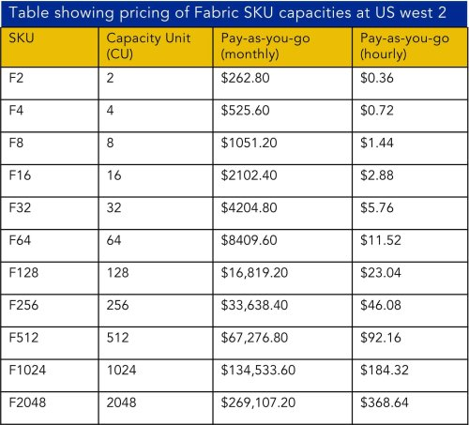
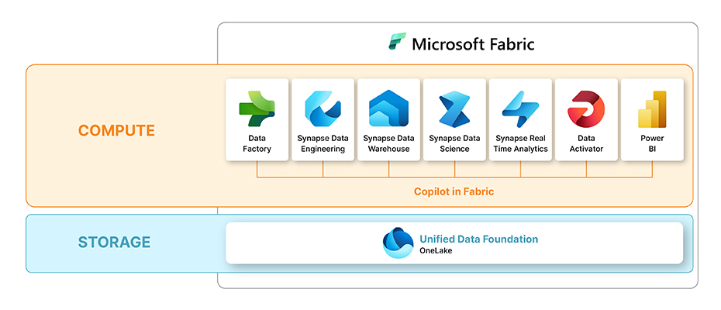
These CU (Capacity Units) define the compute power and resources such as vCores, number of nodes in your cluster that you will use to power components of fabric like notebooks, Data Engineering workloads, AI/ML workloads etc.

Slide 6

Fabric’s Storage Costs

Slide 7
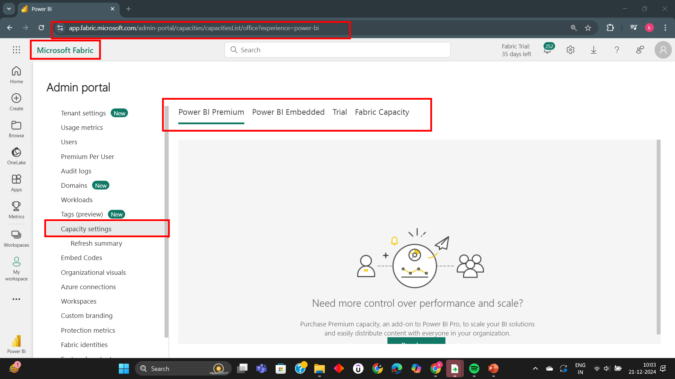
Power BI Licenses in Fabric
This model provides individual, dedicated access to certain Fabric features but with limits on capacity and scale.
if you have existing Power BI per-user licenses (e.g., Power BI Pro or Power BI Premium Per User [PPU]), you can start using Microsoft Fabric without needing to purchase additional licenses, provided your usage aligns with the features and capabilities covered by your current license tier.
Limitations: No access to advanced Fabric features like Data Engineering, Real-Time Analytics, or Data Science.
Not suitable for large-scale collaboration or high-performance workloads in Fabric.
Key Characteristics:
Users are billed on a per-user basis (e.g., $20/user/month for Power BI Premium Per User).
Each user gets their own access to features like data preparation, reporting, and analysis.
Workloads are limited by user-specific quotas, such as:
  Dataset size limits (e.g., 1 GB for Power BI Pro, 100 GB for Premium Per User).
  No capacity sharing—each user is isolated in their usage.

Slide 8
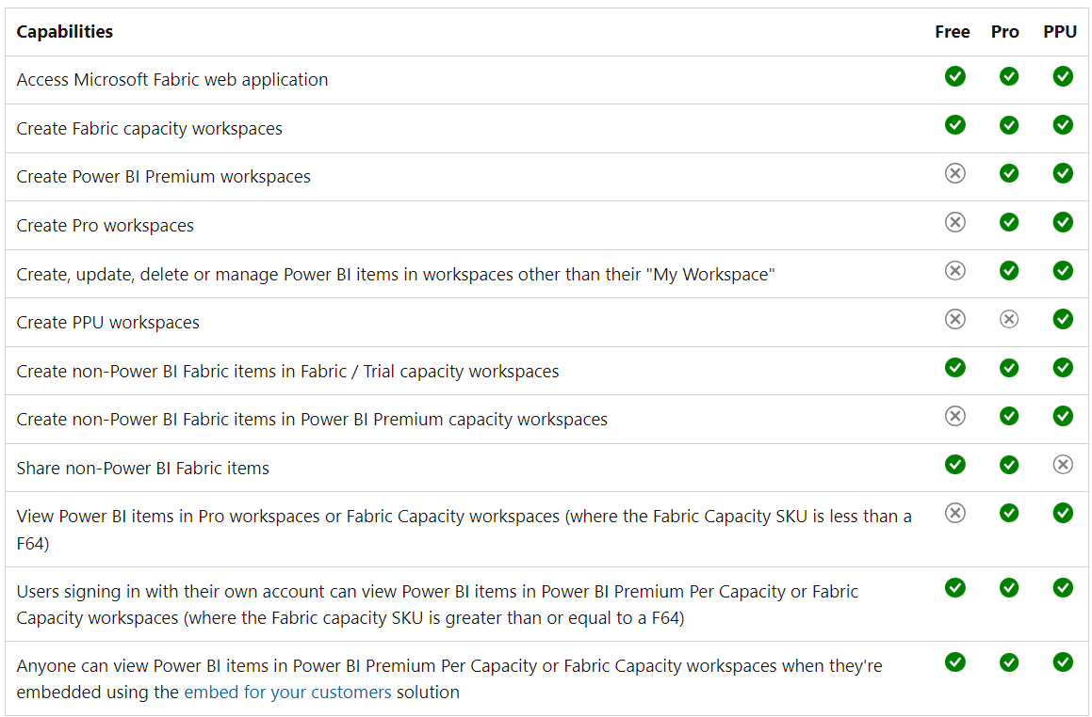

Slide 9
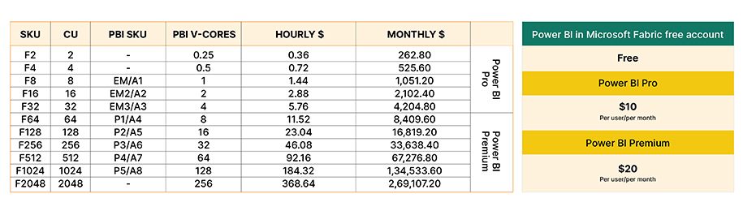
Power BI Pro or Premium Per User (PPU) licenses are required to share Power BI reports unless you have a Power BI Premium capacity (such as F64 or higher).
Combine Fabric capacities with already existing Power BI per user licenses to optimize on costs for small business.
When you purchase a reserved capacity (like F64 or higher), it includes a shared Power BI Premium capacity that allows users to create, share, and consume reports without needing individual Pro/PPU licenses.

Slide 10
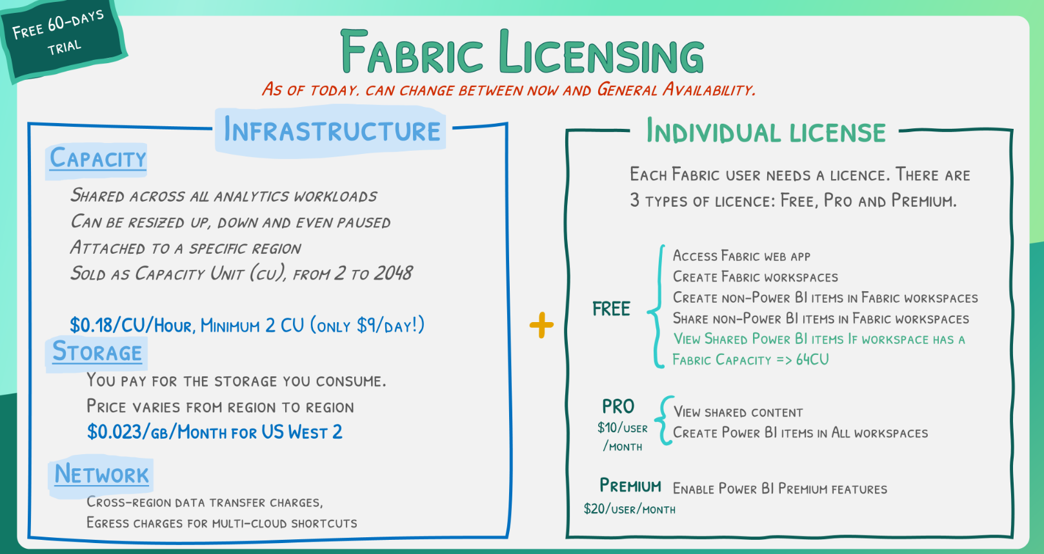
Licensing Summary

